Slide 1
实验3：MapReduce基础编程
151180045 侯汶昕

Slide 2
1. 中文词频统计

Slide 3
1.1 分词Mapper设计
public static class TokenizerMapper extends
Mapper<Object, Text, Text, IntWritable> {
private final static IntWritable one = new IntWritable(1);
private Text word = new Text();
public void map(Object key, Text value, Context context)
throws IOException, InterruptedException {
HanLP.Config.ShowTermNature = false; //关闭词性显示
String[] tmp = value.toString().trim().split("\\t");
String str = tmp[4].replace(" ", "");
List<Term> list = StandardTokenizer.segment(str);
CoreStopWordDictionary.apply(list); //去除停用词
for(int i = 0; i < list.size(); i++){
word.set(list.get(i).toString());
context.write(word, one);
}
}
}
基本沿用了Word Count的框架
使用HanLP进行中文分词
对fulldata.txt文件操作
对新闻标题进行分词
输出键值对：<词, 计数1>

Slide 4
1.2 词频统计Reducer设计
public static class IntSumReducer extends
Reducer<Text, IntWritable, Text, IntWritable> {
private IntWritable result = new IntWritable();
public void reduce(Text key, Iterable<IntWritable> values, Context context)
throws IOException, InterruptedException {
int sum = 0;
int k = context.getConfiguration().getInt("k", 0);
for (IntWritable val : values) {
sum += val.get();
}
if(sum > k){
result.set(sum);
context.write(key, result);
}
}
}
基本沿用了Word Count的框架
统计词频
只保留出现次数大于K次的词
输出键值对：<词，出现次数和>

Slide 5
1.3 实现降序输出
InverseMapper类
将词频作为Key从而实现排序
重写一个OutputKeyComparator类实现降序排序
InverseMapper类源码：
public class InverseMapper<K, V> extends
MapReduceBase implements Mapper<K, V, V, K> {
/** The inverse function. Input keys and values are swapped.*/
public void map(K key, V value,
OutputCollector<V, K> output, Reporter reporter)
throws IOException {
output.collect(value, key);
}
}

Slide 6
1.3 实现降序输出
InverseMapper类
将词频作为Key从而实现排序
重写一个DecreasingComparator类实现降序排序
private static class IntWritableDecreasingComparator extends IntWritable.Comparator{
public int compare(WritableComparable a, WritableComparable b){
return -super.compare(a, b);
}
public int compare(byte[] b1, int s1, int l1, byte[] b2, int s2, int l2){
return -super.compare(b1, s1, l1, b2, s2, l2);
}
}

Slide 7
1.4 Main函数
public static void main(String[] args) throws Exception {
Configuration conf = new Configuration();
String[] otherArgs =
new GenericOptionsParser(conf, args).getRemainingArgs();
Path tempDir = new Path(“ChineseWordCount-temp-" + Integer.toString(new Random().nextInt(Integer.MAX_VALUE)));
conf.setInt("k", Integer.parseInt(otherArgs[2]));
Job job = new Job(conf, "word count");
job.setJarByClass(ChineseWordCount.class);
try{
job.setMapperClass(TokenizerMapper.class);
job.setCombinerClass(IntSumReducer.class);
job.setReducerClass(IntSumReducer.class);
job.setOutputKeyClass(Text.class);
job.setOutputValueClass(IntWritable.class);
FileInputFormat.addInputPath(job, new Path(otherArgs[0]));
FileOutputFormat.setOutputPath(job, tempDir);
job.setOutputFormatClass(SequenceFileOutputFormat.class);
分为两个Job执行：
第一个分词+词频统计
第二个降序输出
第一个Job的输出存在临时目录

Slide 8
1.4 Main函数
if(job.waitForCompletion(true)){
Job sortJob = new Job(conf, "sort");
sortJob.setJarByClass(ChineseWordCount.class);
FileInputFormat.addInputPath(sortJob, tempDir);
sortJob.setInputFormatClass(SequenceFileInputFormat.class);
sortJob.setMapperClass(InverseMapper.class);
sortJob.setNumReduceTasks(1);
FileOutputFormat.setOutputPath(sortJob, new Path(otherArgs[1]));
sortJob.setOutputKeyClass(IntWritable.class);
sortJob.setOutputValueClass(Text.class);
sortJob.setSortComparatorClass(IntWritableDecreasingComparator.class);
System.exit(sortJob.waitForCompletion(true) ? 0:1);
}
}
finally{
FileSystem.get(conf).deleteOnExit(tempDir);
}
}
第二个Job读取第一个Job的输出
设置Mapper为InverseMapper
设置setSortComaratorClass为DecreasingComparator
输出文件到指定的目录下
最后删除临时存储文件

Slide 9
2. 新闻倒排索引

Slide 10
2.1 分词Mapper设计
public static class TokenizerMapper extends
Mapper<Object, Text, Text, Text> {
private Text outputKey = new Text();
private Text outputValue = new Text();
public void map(Object key, Text value, Context context)
throws IOException, InterruptedException {
HanLP.Config.ShowTermNature = false;
String[] tmp = value.toString().trim().split("\\t");
String strCode = tmp[0];
String strURL = tmp[5];
String strTitle = tmp[4].replace(" ", "");
List<Term> listTitleWords = StandardTokenizer.segment(strTitle);
CoreStopWordDictionary.apply(listTitleWords);
for(int i = 0; i < listTitleWords.size(); i++){
outputKey.set(listTitleWords.get(i).toString() + "#" + strCode);
outputValue.set(strURL + "#" + "1");
context.write(outputKey, outputValue);
}
}
输入Value：
Code\tName\tDate\tTime\tTitle\tURL
对Title进行分词
输出键值对:
<Word#Code, URL#1>

Slide 11
2.2 MainReducer设计
public void reduce(Text key, Iterable<Text> values, Context context) throws IOException, InterruptedException {
int sum = 0;
Text word = new Text();
String titleWord = key.toString().split("#")[0];
String code = key.toString().split("#")[1];
String URL;
StringBuilder strBuilder = new StringBuilder("[");
int Occurrence;
for (Text val : values) {
URL = val.toString().split("#")[0];
strBuilder.append(URL+", ");
Occurrence = Integer.parseInt(val.toString().split("#")[1]);
sum += Occurrence;
}
strBuilder.replace(strBuilder.length()-2, strBuilder.length(), "]");
word.set(titleWord + "#" + code + "#" + strBuilder.toString());
result.set(sum);
context.write(word, result);
}
}
输入键值对:
<Word#Code, URL#1>
词频统计+合并URL们
输出键值对:
<Word#Code#URLs, Frequency>

Slide 12
2.3 二次排序Mapper设计
读取MainReducer的临时输出文件
输入键值对:
<Word#Code#URLs, Frequency>
整理格式
输出键值对：
<Word#Frequency#Code#URLs, Null>
public static class SecondSortMapper extends Mapper<Text, IntWritable, Text, NullWritable>{
private String titleWord, occurrence, code, URL;
public void map(Text key, IntWritable value, Context context) throws IOException, InterruptedException{
titleWord = key.toString().split("#")[0];
occurrence = value.toString();
code = key.toString().split("#")[1];
URL = key.toString().split("#")[2];
context.write(new Text(titleWord+"#"+occurrence+"#"+code+"#"+URL), NullWritable.get());
}
}

Slide 13
2.4 二次排序Partitioner设计
仅按Word进行分区
public static class SecondSortPartitioner extends HashPartitioner<Text, NullWritable>
{
public int getPartition(Text key, NullWritable value, int numReduceTasks) {
String term = new String();
term = key.toString().split("#")[0];
return super.getPartition(new Text(term), value, numReduceTasks);
}
}

Slide 14
2.5 二次排序Reducer设计
最终整理成输出格式
public static class SecondSortReducer extends Reducer<Text, NullWritable, Text, NullWritable>{
private Text word = new Text();
@Override
public void reduce(Text key, Iterable<NullWritable> value, Context context)
throws IOException, InterruptedException{
word.set(key.toString().replaceAll("#", ", "));
context.write(word, NullWritable.get());
}
}

Slide 15
2.6 实现二次、降序输出
先比较Word，再比较Frequency
private static class SecondSortComparator extends WritableComparator{
protected SecondSortComparator(){
super(Text.class, true);
}
public int compare(WritableComparable a, WritableComparable b) {
Text o1 = (Text) a;
Text o2 = (Text) b;
int occurrence1 = Integer.parseInt(o1.toString().split("#")[1]);
String titleWord1 = o1.toString().split("#")[0];
int occurrence2 = Integer.parseInt(o2.toString().split("#")[1]);
String titleWord2 = o2.toString().split("#")[0];
if(! titleWord1.equals(titleWord2))
return titleWord1.compareTo(titleWord2);
else
return occurrence2 - occurrence1;
}
}

Slide 16
2.7 Main函数
public static void main(String[] args) throws Exception {
Configuration conf = new Configuration();
String[] otherArgs =
new GenericOptionsParser(conf, args).getRemainingArgs();
Path tempDir = new Path("InvertedIndex-temp-" +
Integer.toString(new Random().nextInt(Integer.MAX_VALUE)));
Job job = new Job(conf, "inverted index");
job.setJarByClass(InvertedIndex.class);
try{
job.setMapperClass(TokenizerMapper.class);
job.setMapOutputKeyClass(Text.class);
job.setMapOutputValueClass(Text.class);
job.setReducerClass(MainReducer.class);
job.setOutputKeyClass(Text.class);
job.setOutputValueClass(IntWritable.class);
FileInputFormat.addInputPath(job, new Path(otherArgs[0]));
FileOutputFormat.setOutputPath(job, tempDir);
job.setOutputFormatClass(SequenceFileOutputFormat.class);

Slide 17
2.7 Main函数
if(job.waitForCompletion(true)){
Job sortJob = new Job(conf, "sort");
sortJob.setJarByClass(InvertedIndex.class);
FileInputFormat.addInputPath(sortJob, tempDir);
sortJob.setInputFormatClass(SequenceFileInputFormat.class);
sortJob.setMapperClass(SecondSortMapper.class);
sortJob.setMapOutputKeyClass(Text.class);
sortJob.setMapOutputValueClass(NullWritable.class);
sortJob.setPartitionerClass(SecondSortPartitioner.class);
sortJob.setReducerClass(SecondSortReducer.class);
sortJob.setNumReduceTasks(1);
FileOutputFormat.setOutputPath(sortJob, new Path(otherArgs[1]));
sortJob.setOutputKeyClass(Text.class);
sortJob.setOutputValueClass(NullWritable.class);
sortJob.setSortComparatorClass(SecondSortComparator.class);;
System.exit(sortJob.waitForCompletion(true) ? 0:1);
}
}
finally{
FileSystem.get(conf).deleteOnExit(tempDir);
}
}
注意设置Partitioner和SortComparator

Slide 18
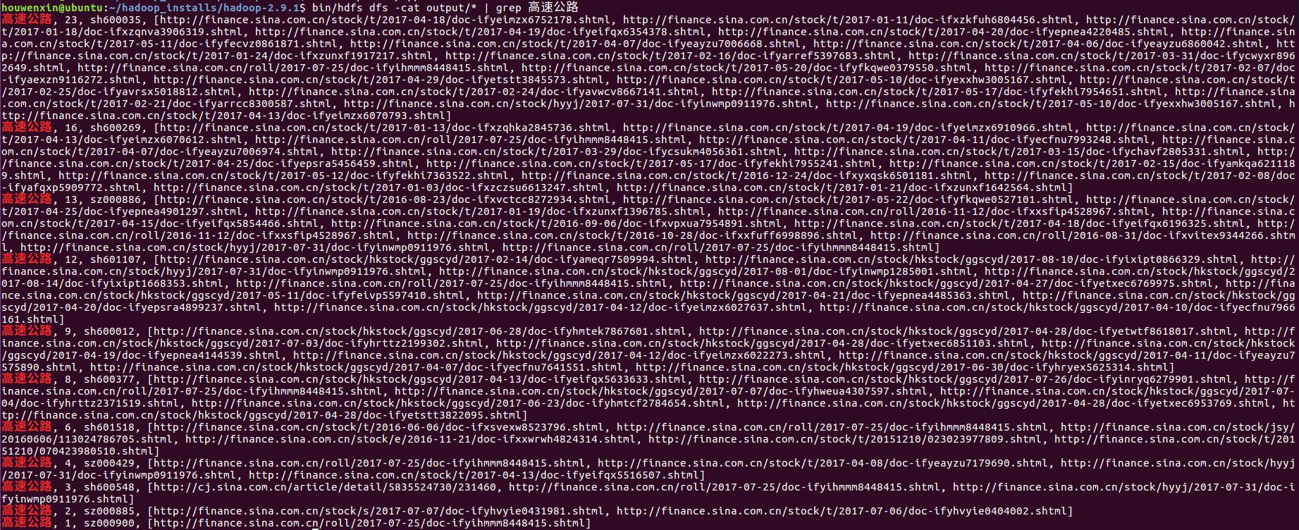
2.8 运行结果

Slide 19
谢 谢 ！

